Slide 1
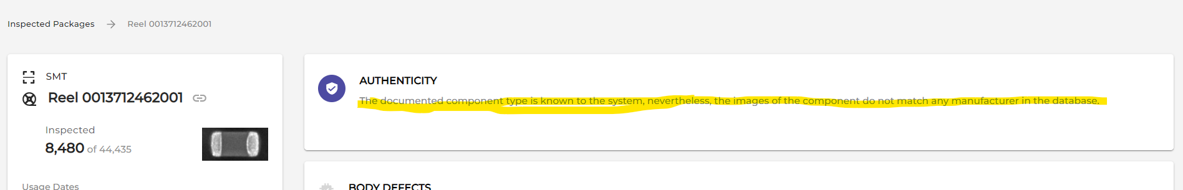

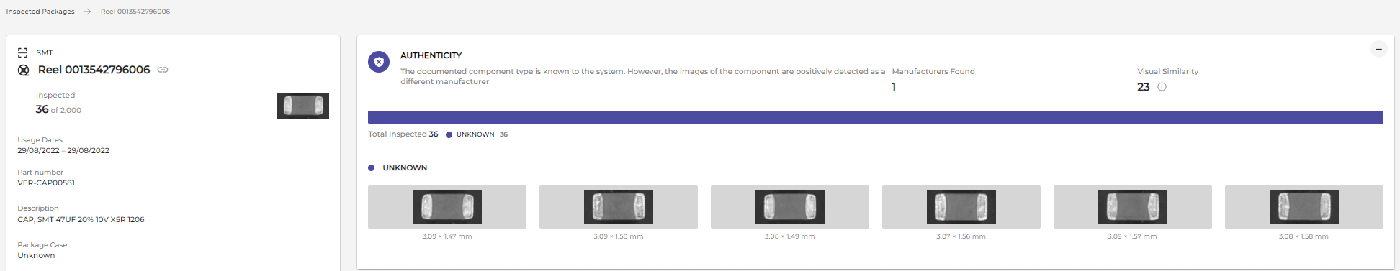
This text should appear only when we performed the auth test and found ‘unknown’ manufacturer. In such case, I would expect to see the components tested in this test and the identified manufacturer should have indicate ‘unknown’
Not showing any component and not indicating the ‘unknown’ manufacturer is not logic.
Below is an example of a correct usage in the same sentence.

Slide 2
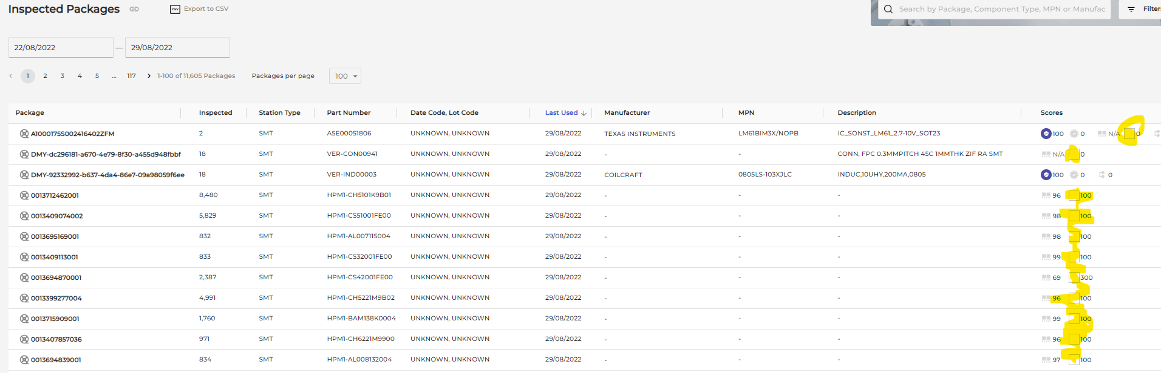
What is this empty icon test (Marking?)? Need to correct the interface

Slide 3
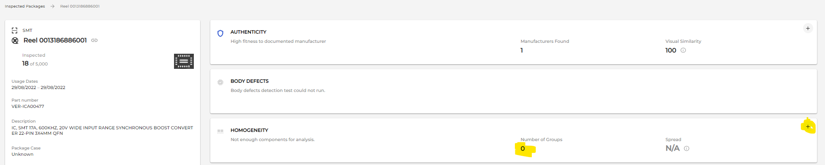
If no homogeneity test run, why we indicate the 0 and the + signs? Why don’t we leave it empty with the comment that homogeneity test didn’t run since the qty is too low ?

Slide 4
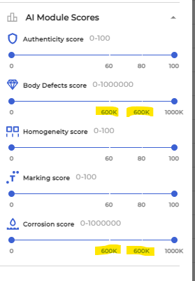
Same numbers appear on different places of the bars.

Slide 5
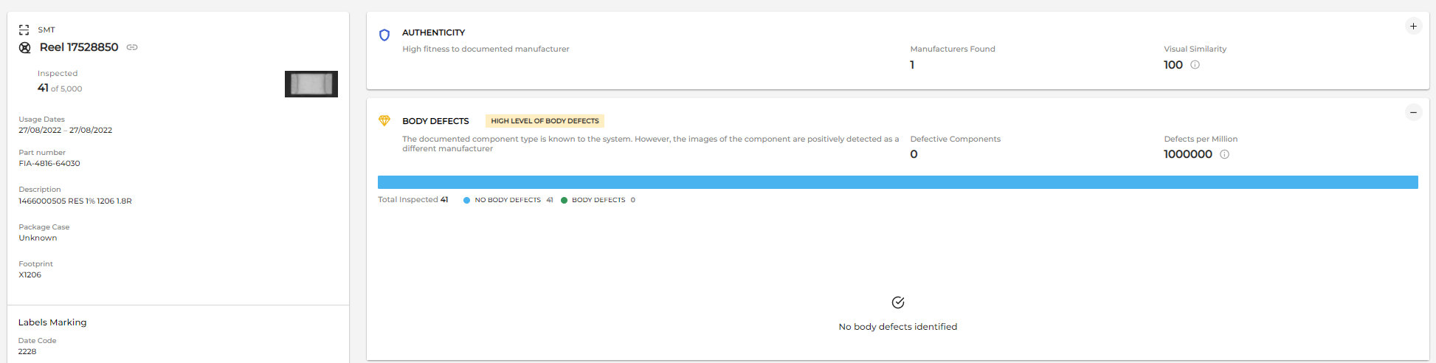
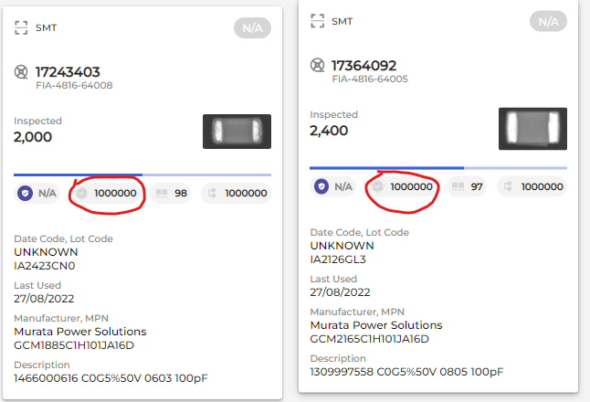
If no defects found, why we indicate 1000000 defected per million?
This issue also fails the body defects filter since when I try to filter only the issues with the body defects, it takes those cases that shows 1000000 DPM and present it although there are no body defects in it.
This issue also impacts the preview as it shows 1000000 DPM while this is actually 0

Slide 6
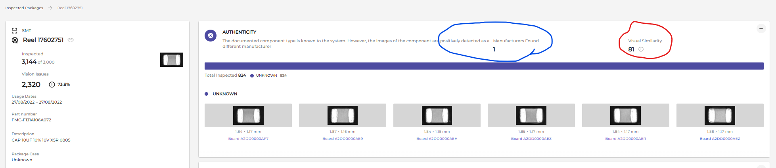
Red marking – we see score lower than 85. I would expect to get highlighted alert but we don’t see it.
Blue marking – the comment is too close to the manufacturer found section. When reading the comment it looks like the same sentence.
Comment content – the comment here make no sense in this case. We are indicating a case of unknown manufacturer found. However, the comment is saying we identified it as other manufacturer. If we identified different manufacturer then what is the name of this one? For sure cannot be unknown. Logic is broken here.

Slide 7
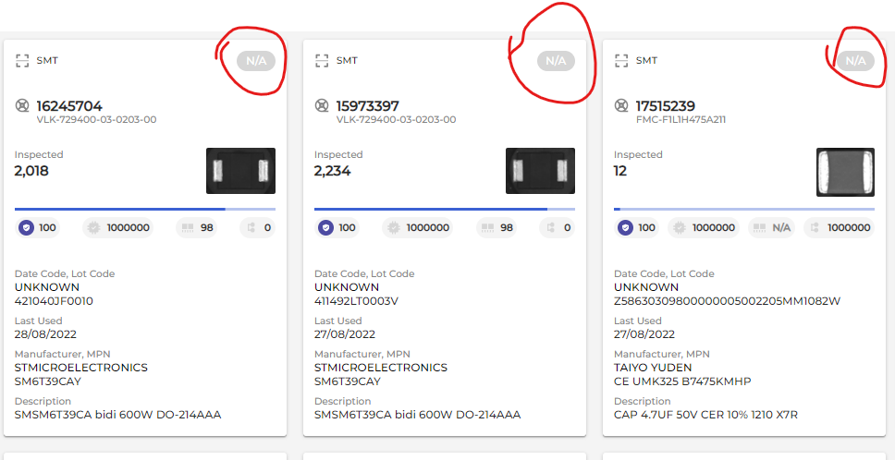
The whole purpose of this new scoring method was to remove the scores from the reel. Why we keep this NA indicator in all reels? Need to be removed.

Slide 8
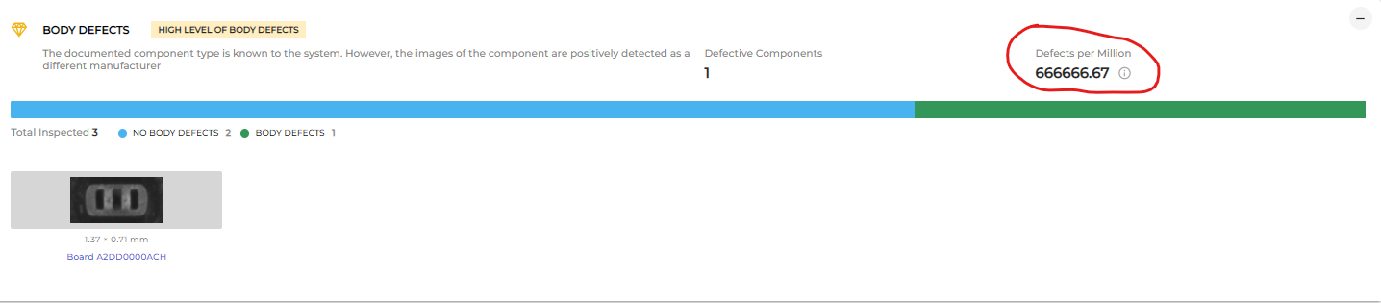
The number format should not include decimal digits.
The number format should be: X,XXX,XXX
Number over 2000 DPM should indicate “>2000” and not the huge numbers we get now. This is valid for all other modules which are measured by DPM.

Slide 9
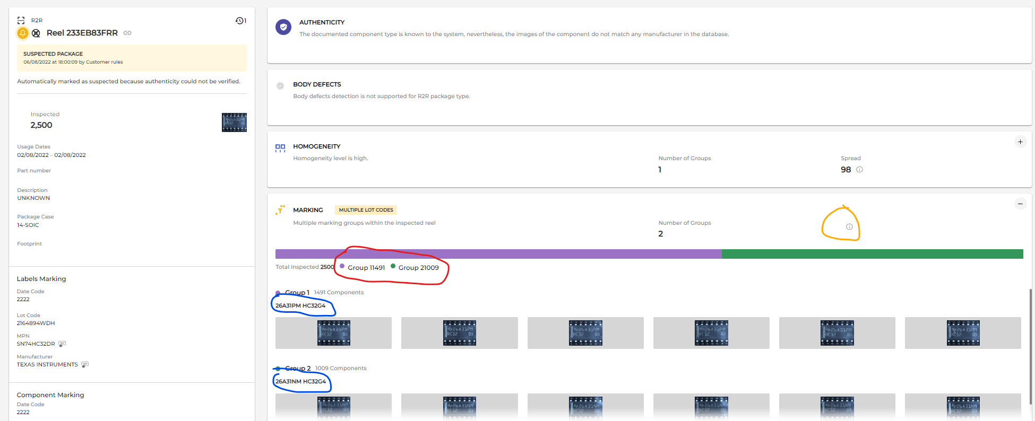
Orange marking – missing the score. Should be like the one we see above in the homo test
Red marking – missing space between he group number and the quantity
Blue marking – Why we don’t run the AOI algorithm? We keep running here the old one that is not providing the transcoded data.

Slide 10
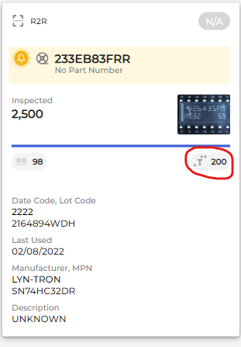
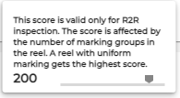
What 200 means? Max score can be 100

Slide 11
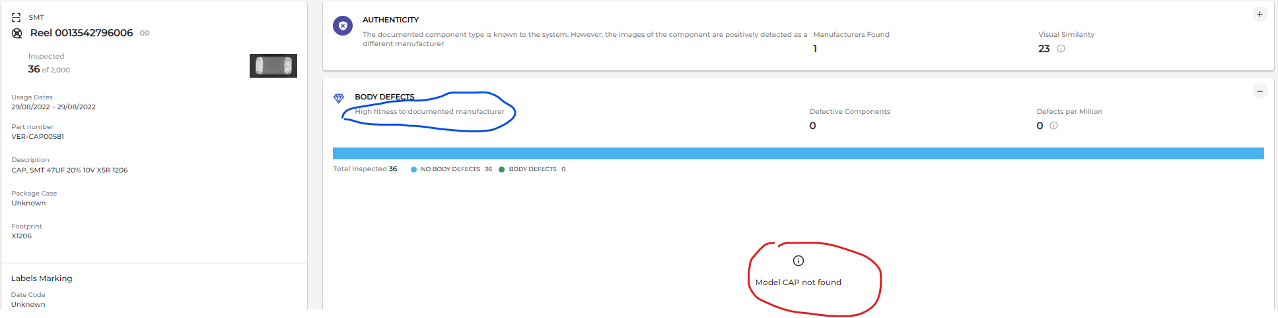
Red marking – this comment is not relevant to Body defects or Corrosion. From some reason we see it in both places where it makes no sense. This is a proper comment for Auth test.
Blue marking – The comment fits auth test, not Body defect or corrosion tests
In this case, if we could indicate there are no body defects, why do we claim there is no model?

Slide 12
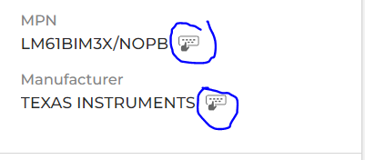
Icon is not clear enough. Missing tooltip when hovering or clicking

Slide 13
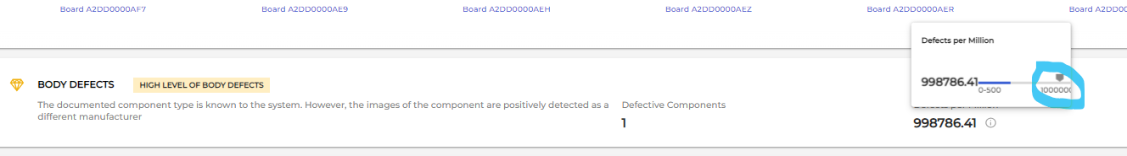
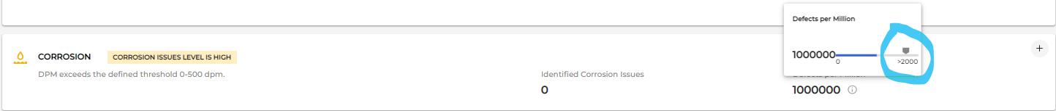
Inconsistent scale. In the body defect we are using max DPM as 1000000 while in the corrosion we are using 2000. both should be 2000 and not more.

Slide 14
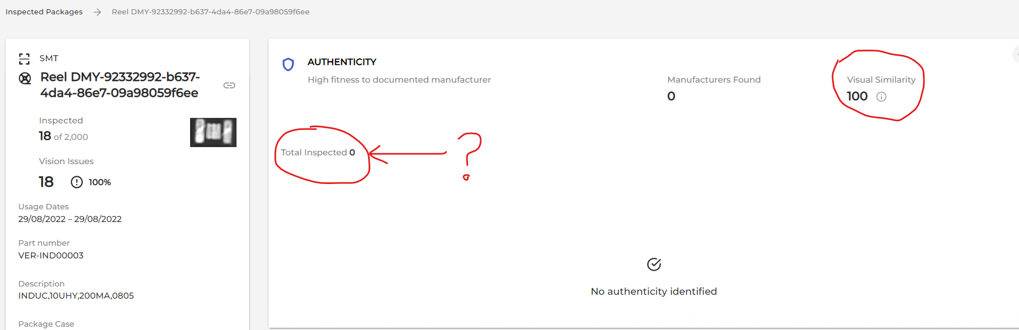
Visual similarity is indicating 100 while no component inspected.

Slide 15
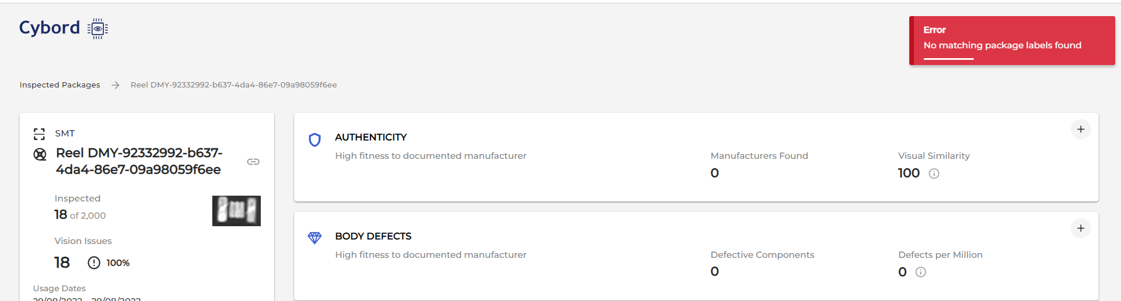
Error messages appear

