Slide 1
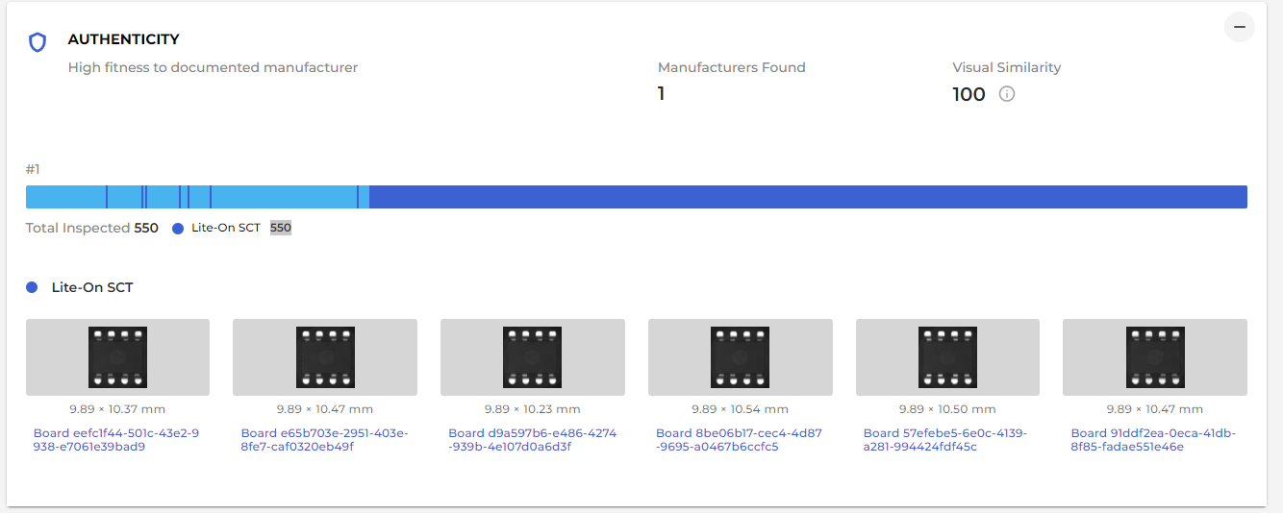
https://b.cybord.ai/package/2242004062/MEL-FLX1
Only 1 group was found – Why bar is indicating 2 colours?

Slide 2
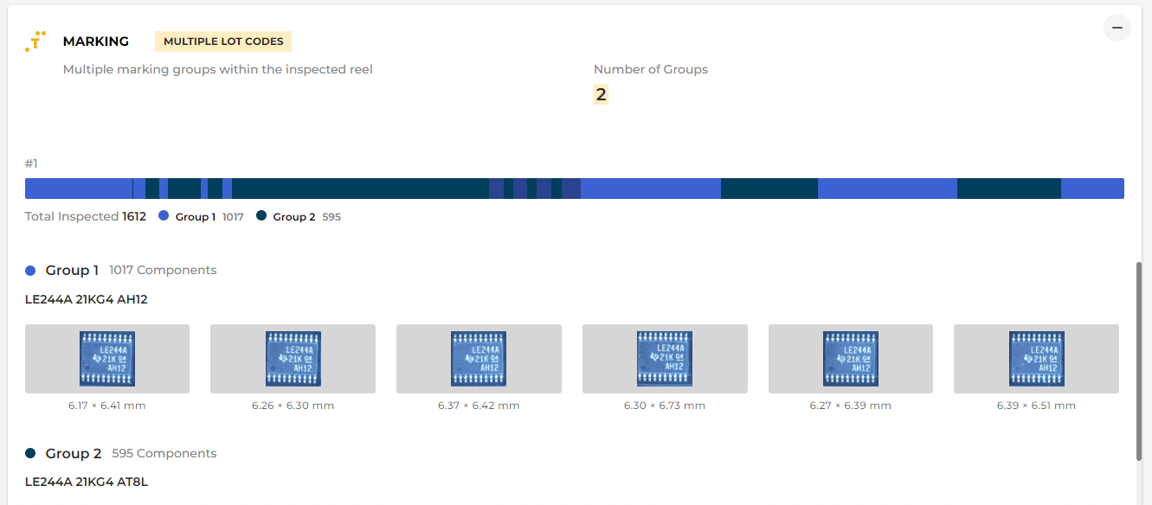
https://b.cybord.ai/package/VUS0010233220707137700054/FOX-CHN1
Colour #2
Colour #1
Colour #3
2 groups are indicated – Bar is showing 3 different colours

Slide 3
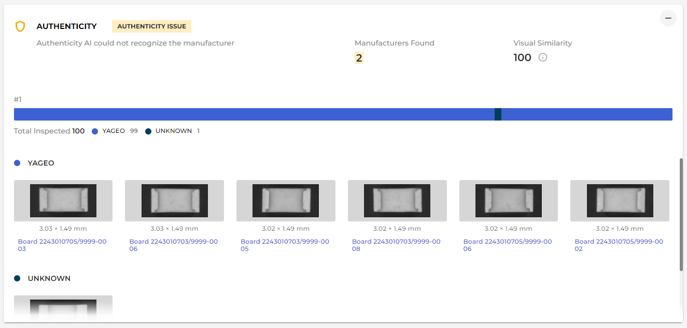
https://b.cybord.ai/package/2208007771/MEL-FLX1
Only 1 unit found unknown but the thickness of the line is way too big, looks like it is a group.
We should make sure we don’t use too thin lines so it can still be noticeable, however, we
Cannot use such thick lines as a minimum as it mislead the customers

